Slide 1

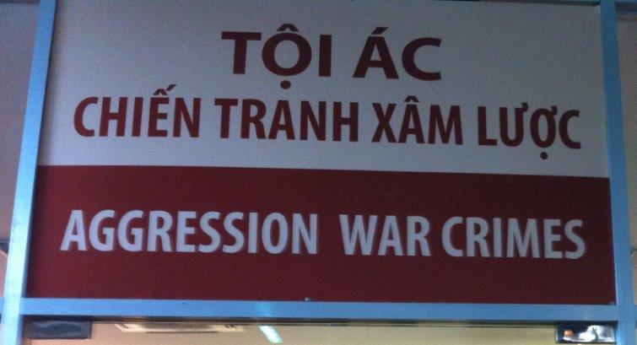
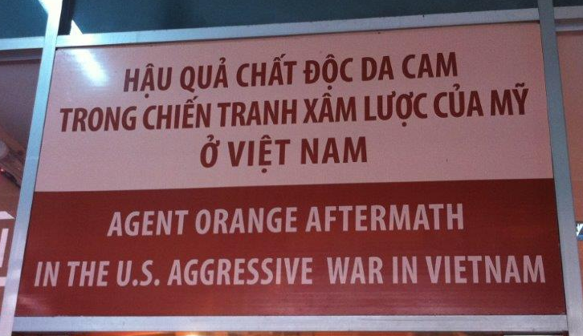
The American War:
History in modern Vietnam
Brendan toohey
Htasa 2017 https://brendantoohey.com/htasa-2017/

Slide 2
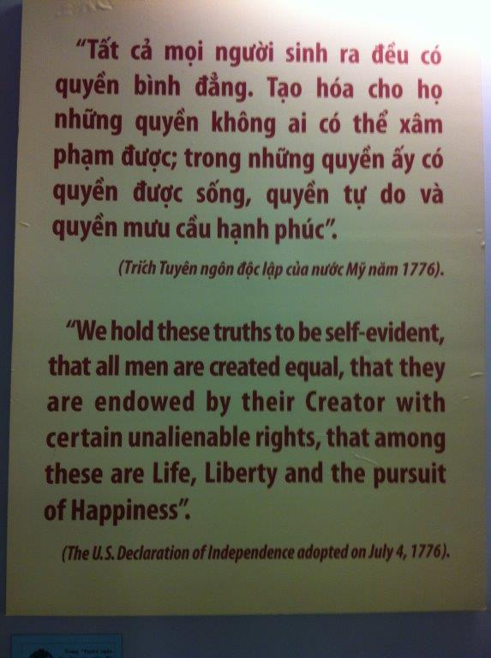
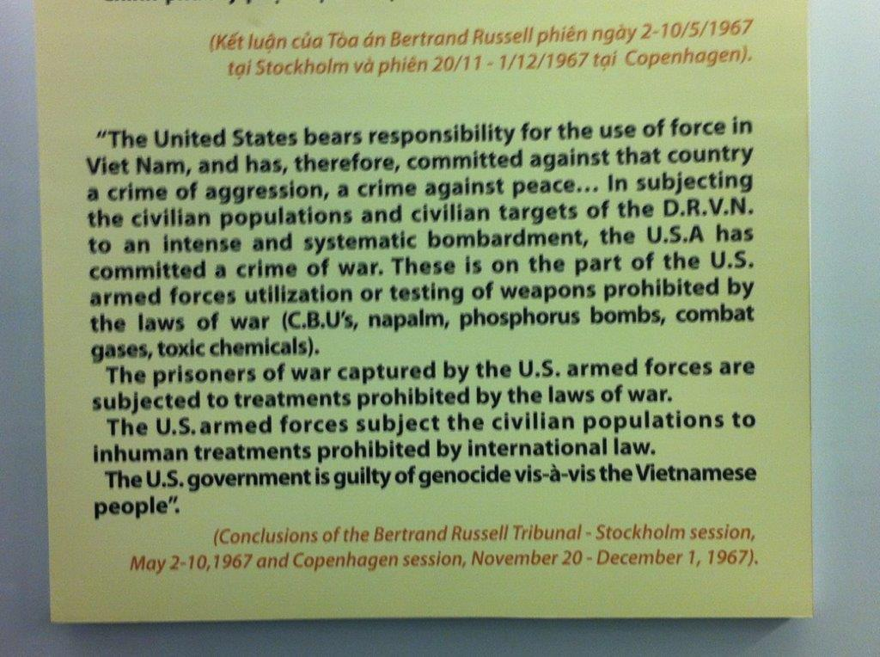
War Remnants Museum, HCMC http://warremnantsmuseum.com/

Slide 3
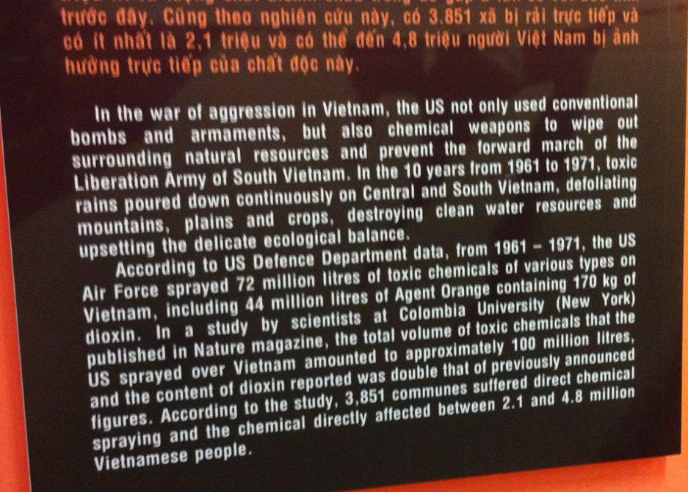
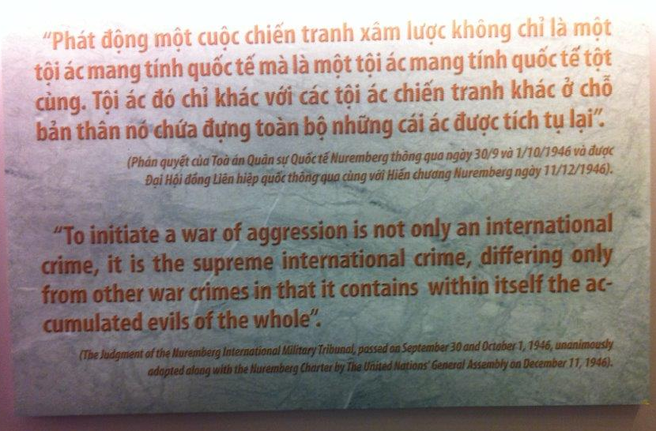
War Remnants Museum, HCMC

Slide 4
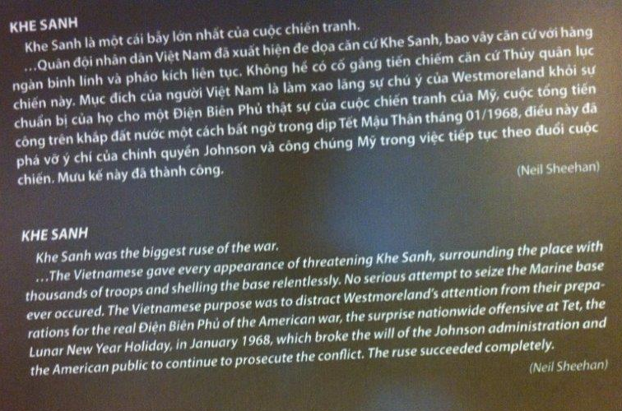
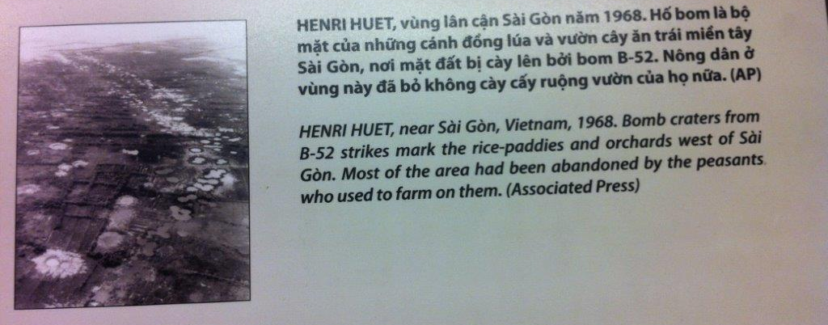
War Remnants Museum, HCMC

Slide 5
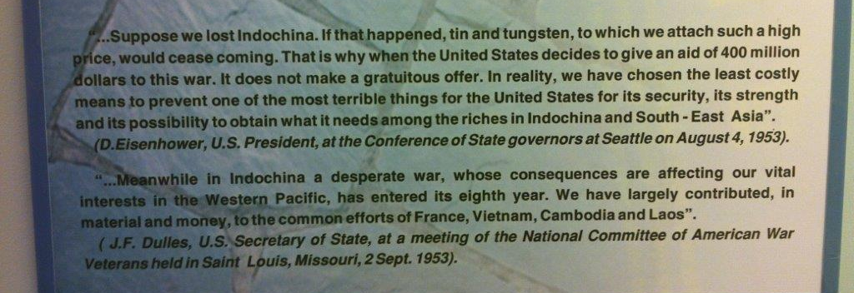
War Remnants Museum, HCMC

Slide 6
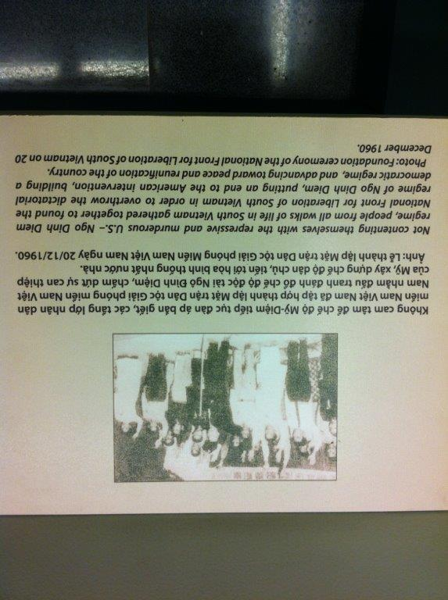
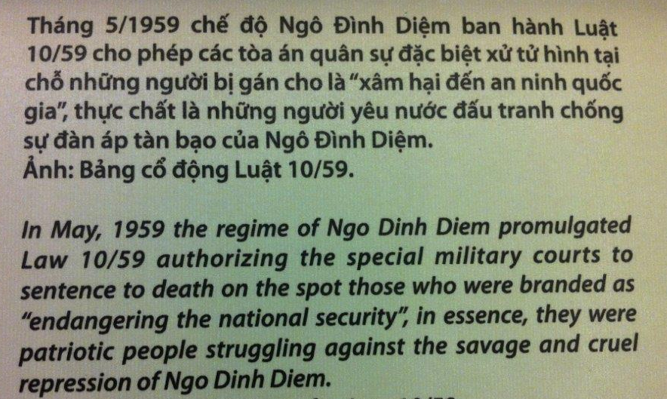
War Remnants Museum, HCMC

Slide 7
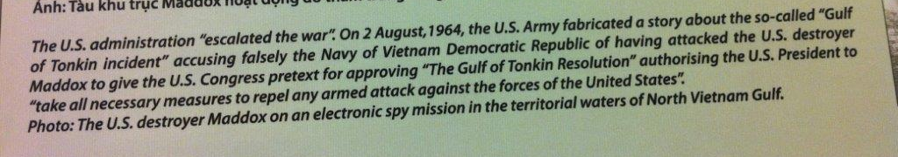
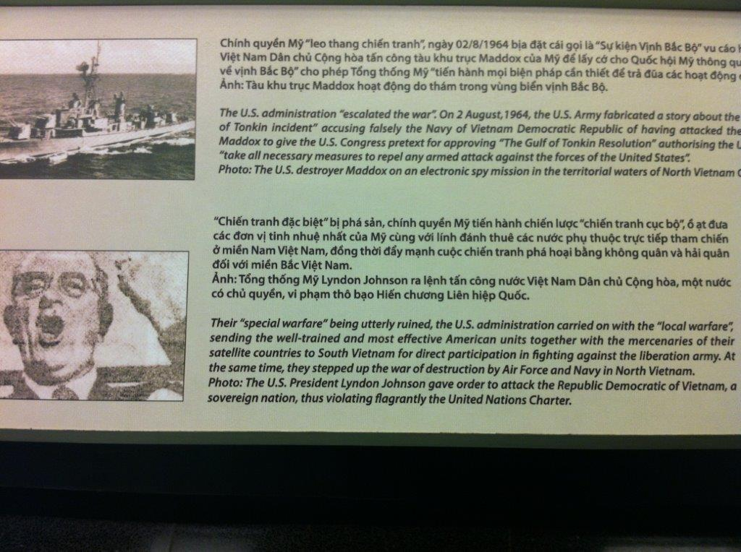
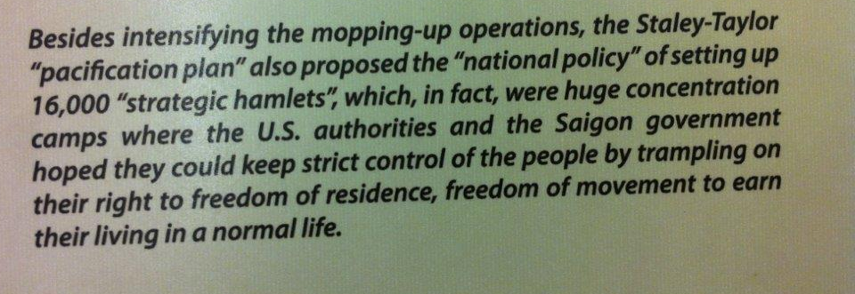
War Remnants Museum, HCMC

Slide 8
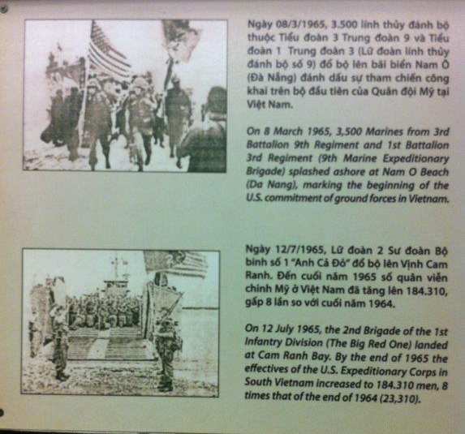
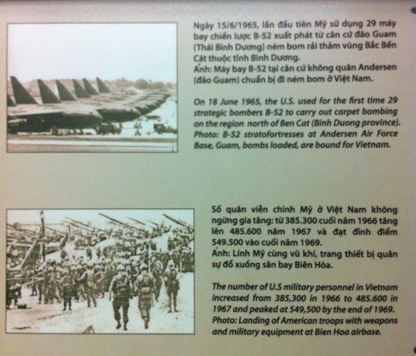
War Remnants Museum, HCMC

Slide 9
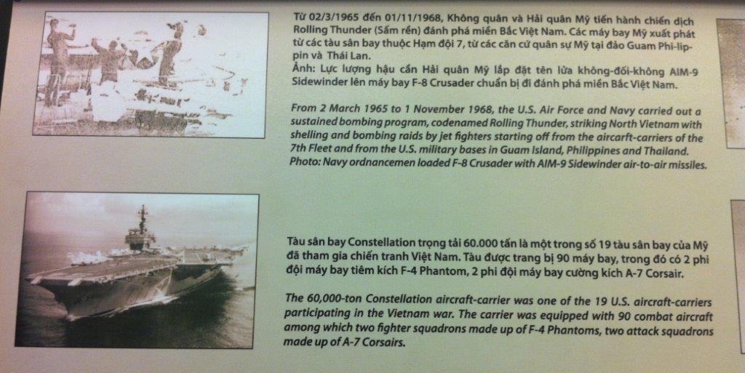
War Remnants Museum, HCMC

Slide 10
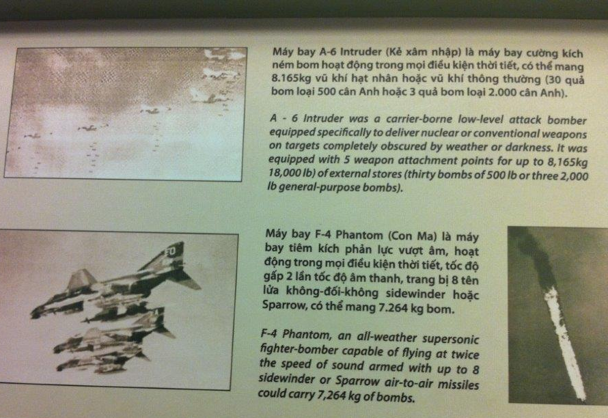
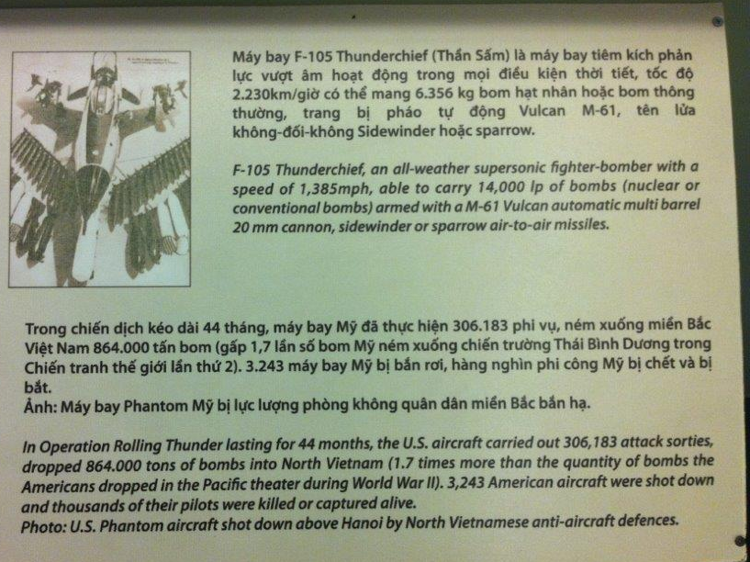
War Remnants Museum, HCMC

Slide 11
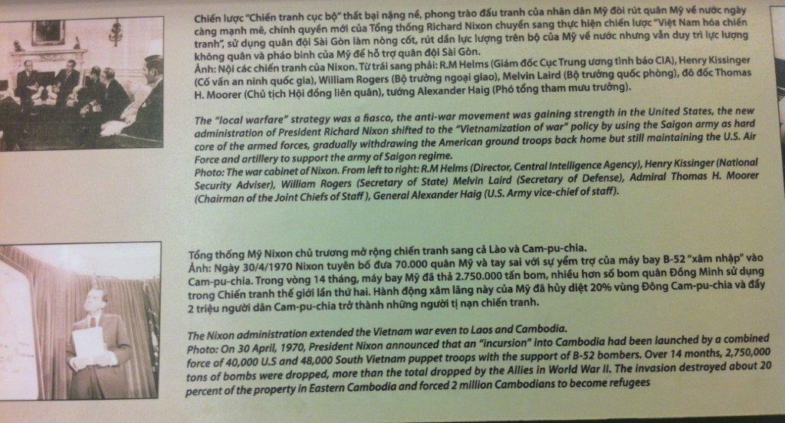
War Remnants Museum, HCMC

Slide 12
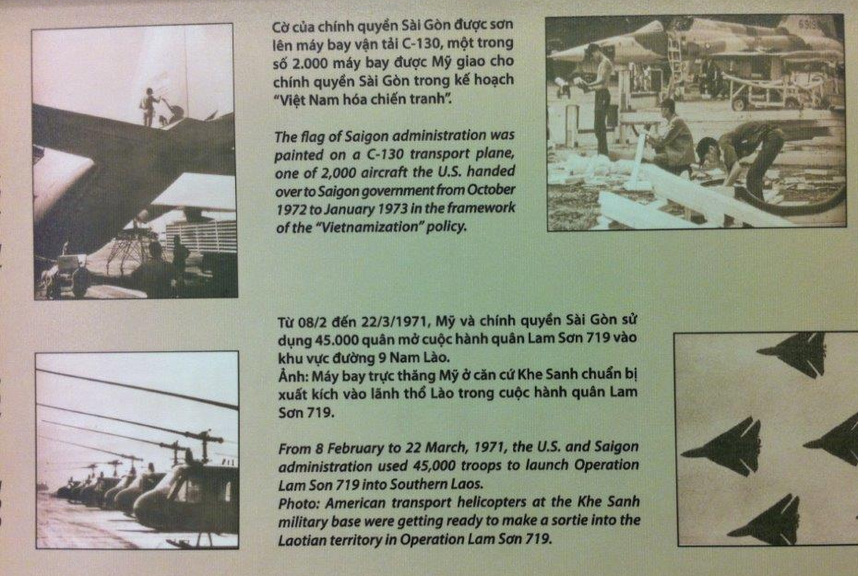
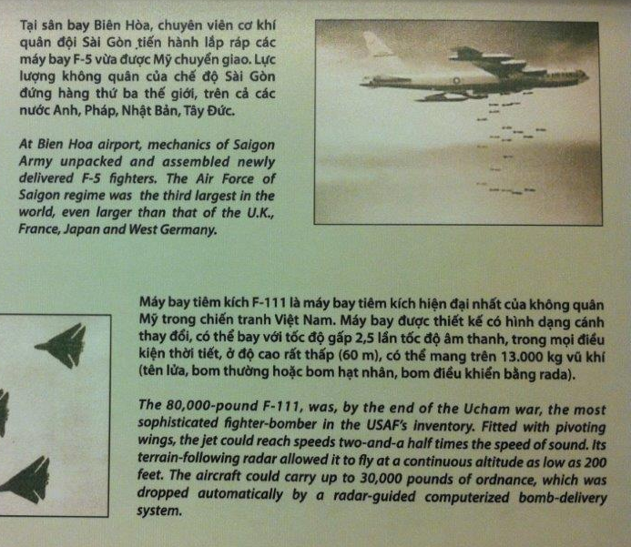
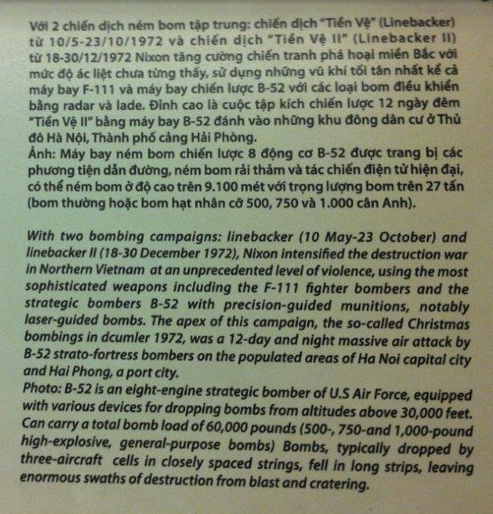
War Remnants Museum, HCMC

Slide 13
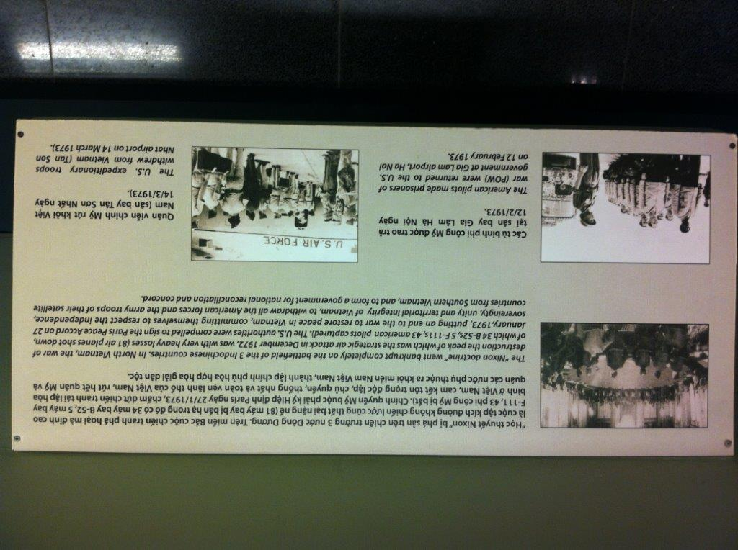
War Remnants Museum, HCMC

Slide 14
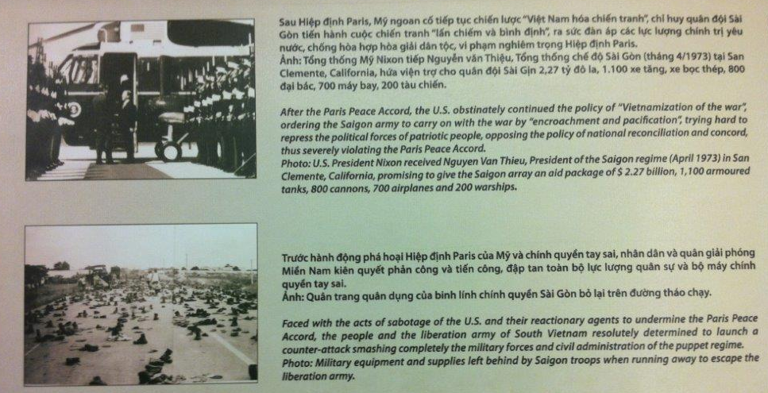
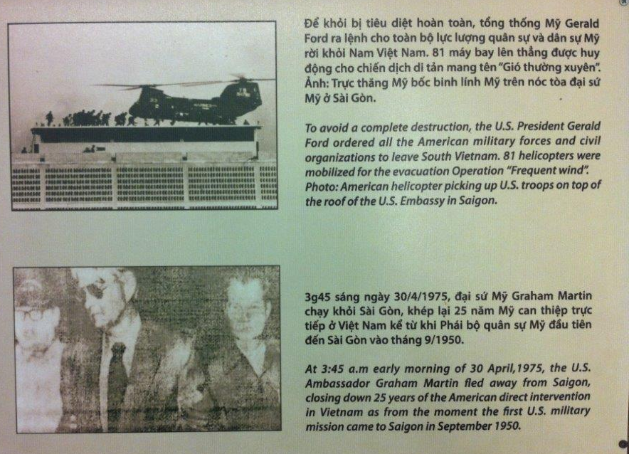
War Remnants Museum, HCMC

Slide 15
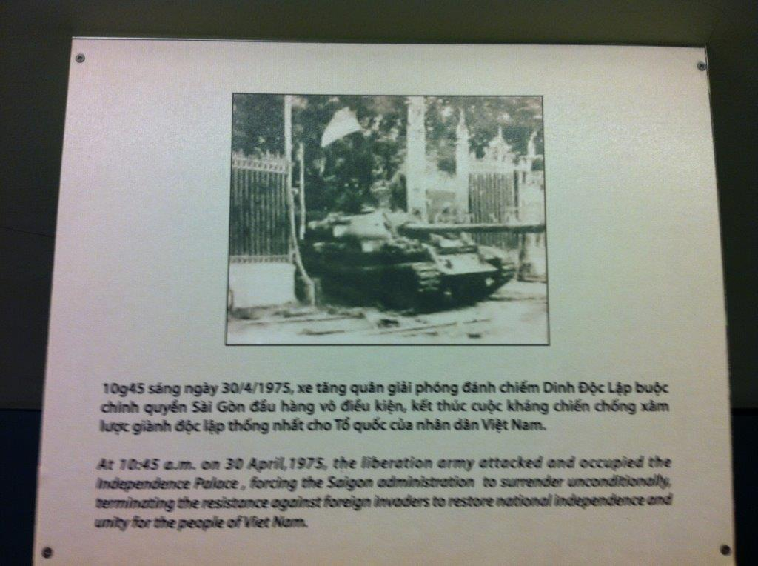
War Remnants Museum, HCMC

Slide 16
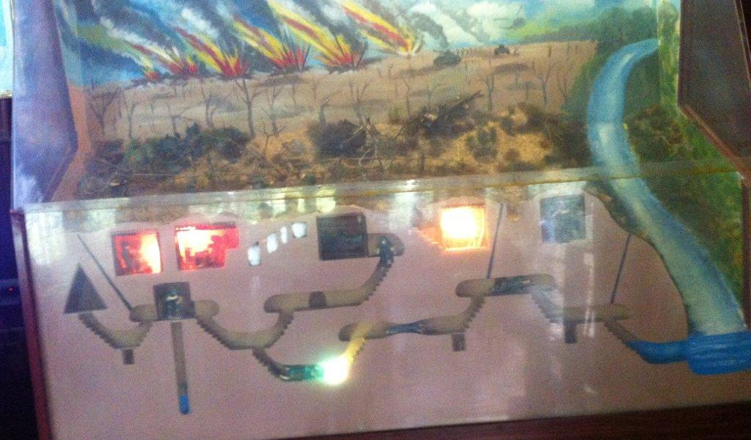
Cu Chi Tunnel Complex

Slide 17
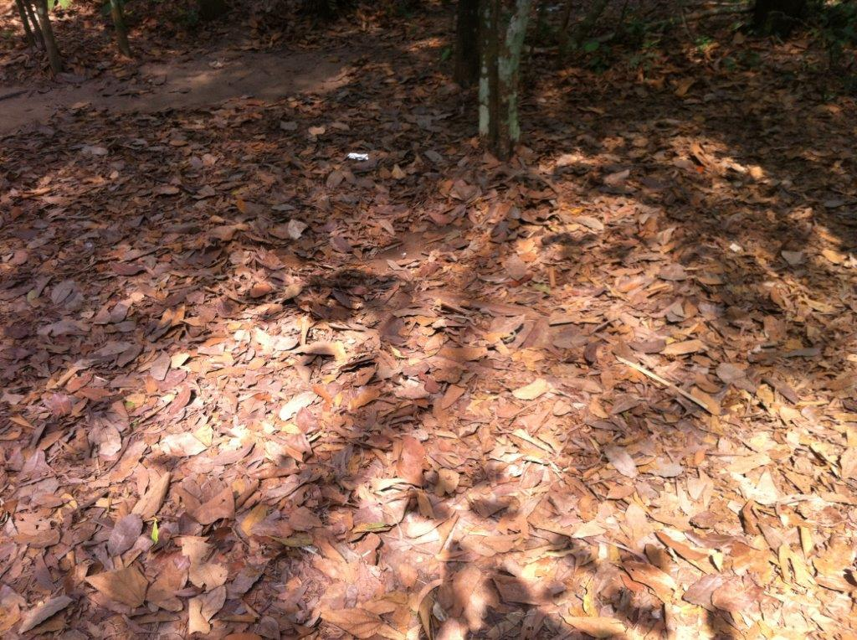
Cu Chi Tunnel Complex

Slide 18
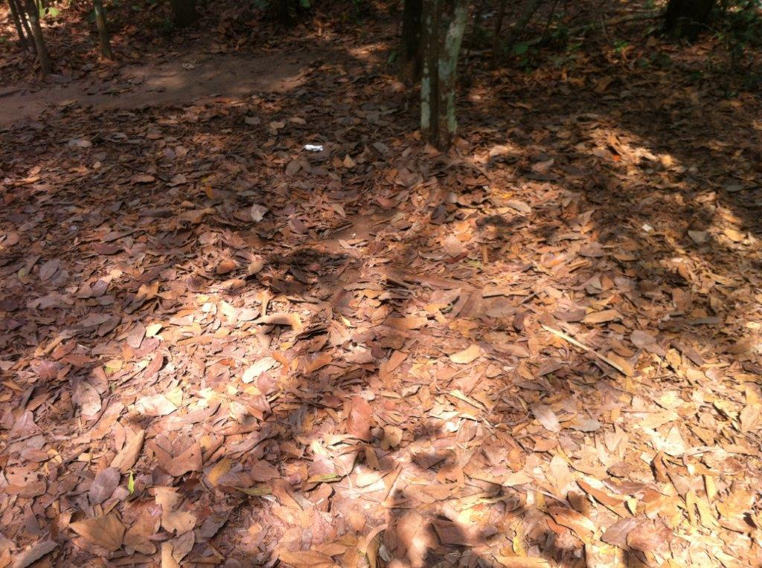
Cu Chi Tunnel Complex

Slide 19
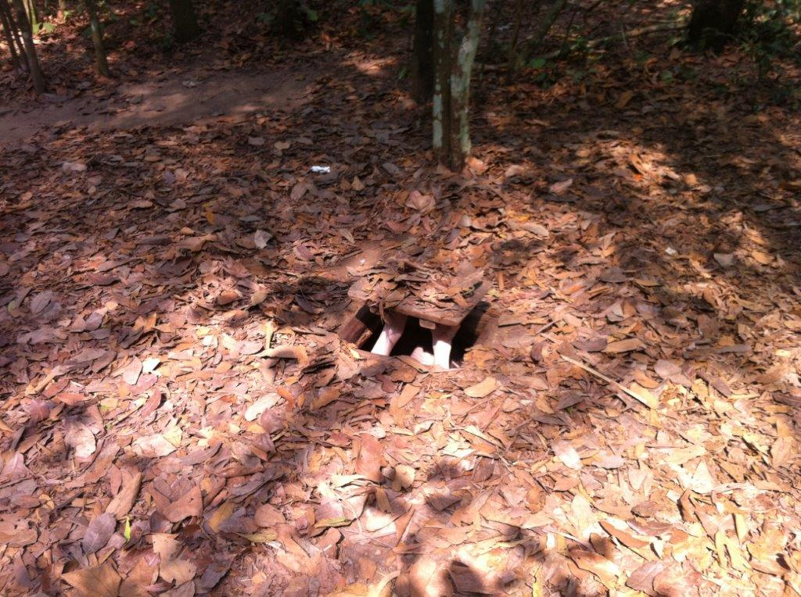
Cu Chi Tunnel Complex

Slide 20
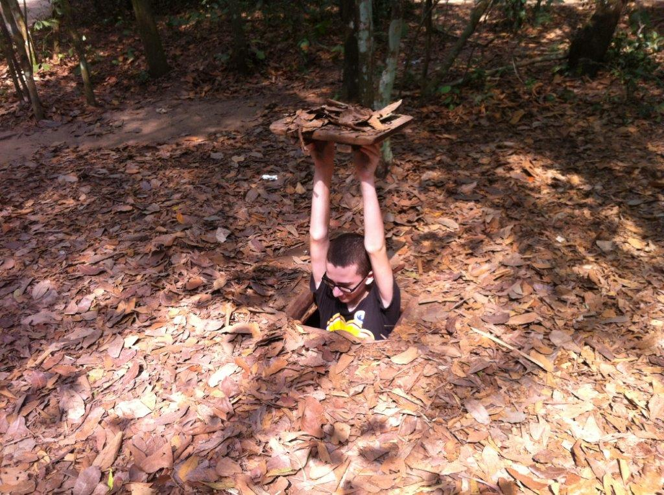
Cu Chi Tunnel Complex

Slide 21
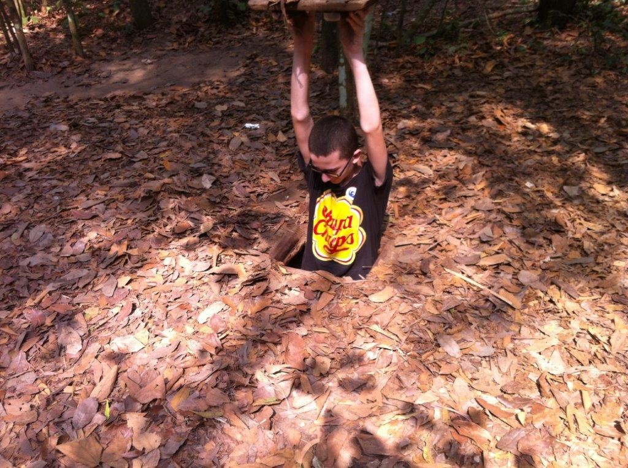
Cu Chi Tunnel Complex

Slide 22
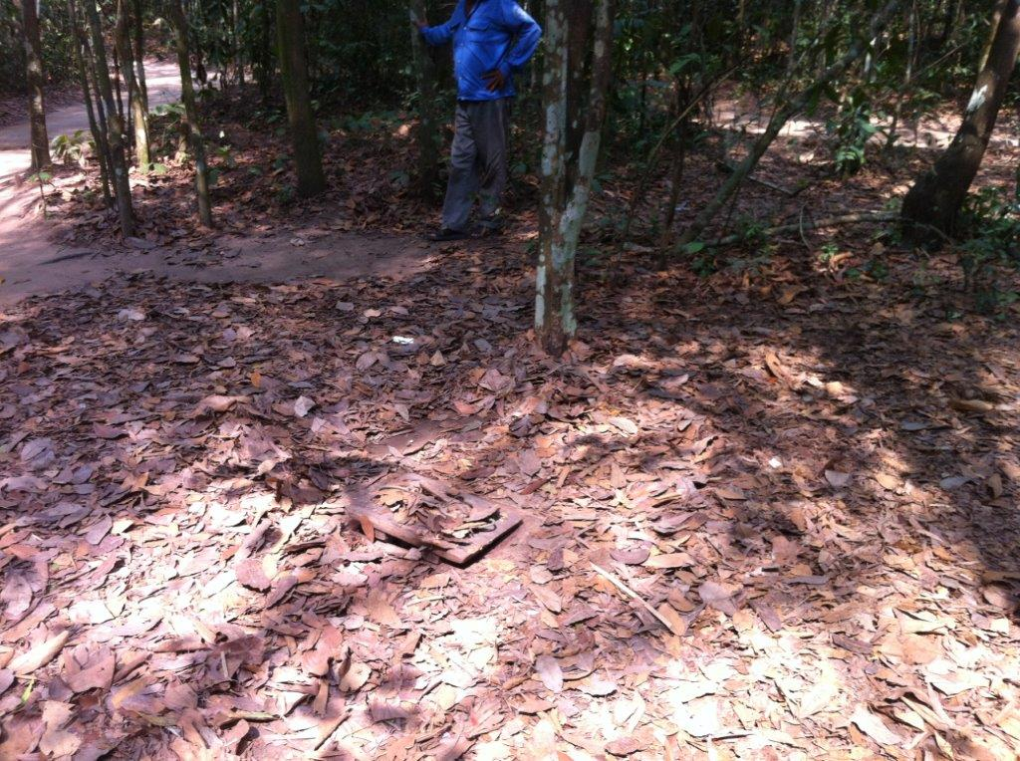
Cu Chi Tunnel Complex

Slide 23
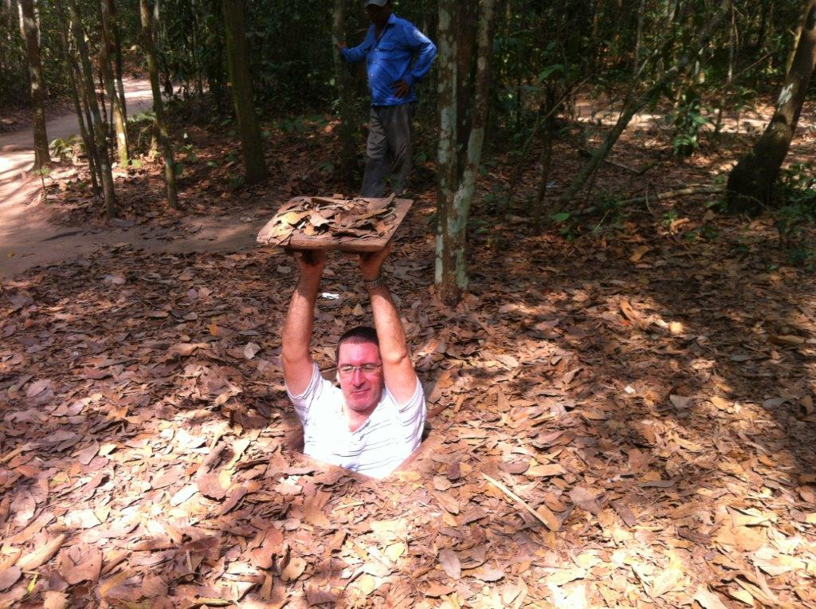
Cu Chi Tunnel Complex

Slide 24
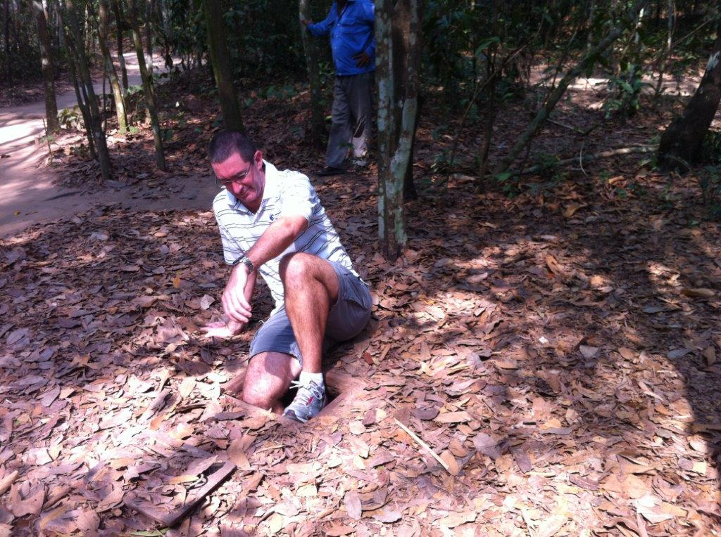
Cu Chi Tunnel Complex

Slide 25
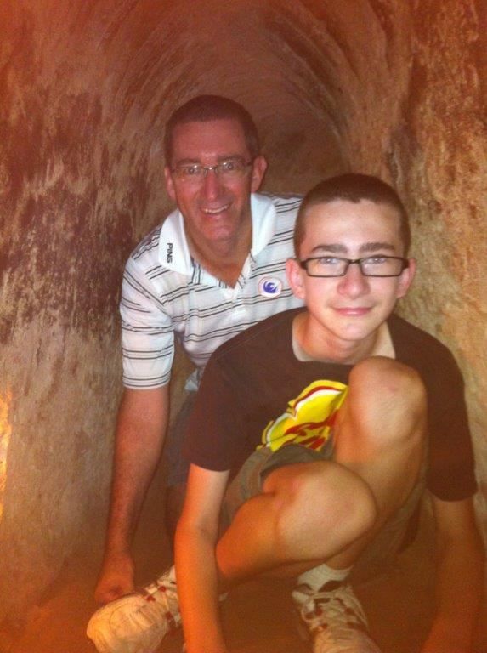
Cu Chi Tunnel Complex
Lucky they had excavated the tourist tunnels out a bit! 185cm & 90kg – and I only just fit!

Slide 26
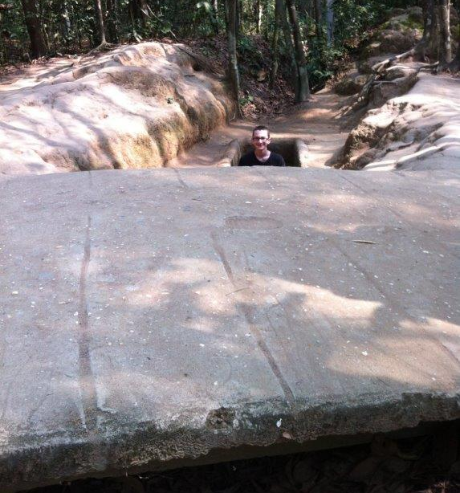
Cu Chi Tunnel Complex
Fill that gully in with leaves and debris and guerrillas could ‘vanish’

Slide 27
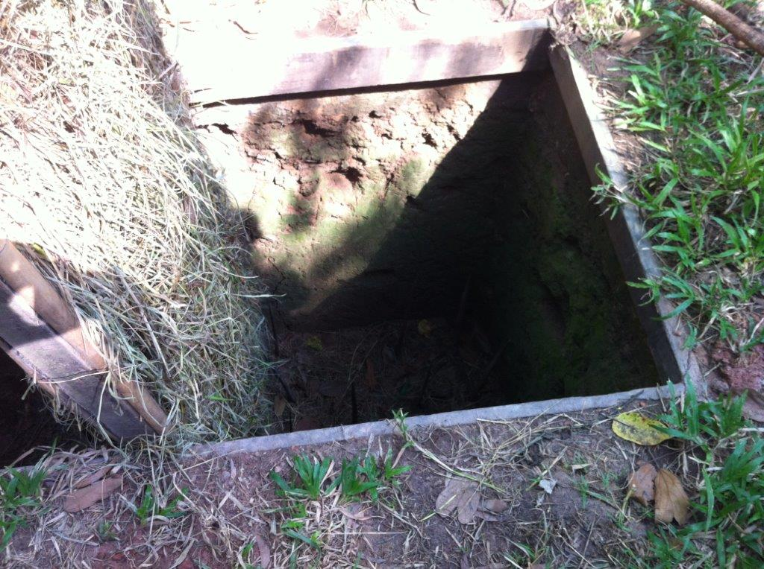
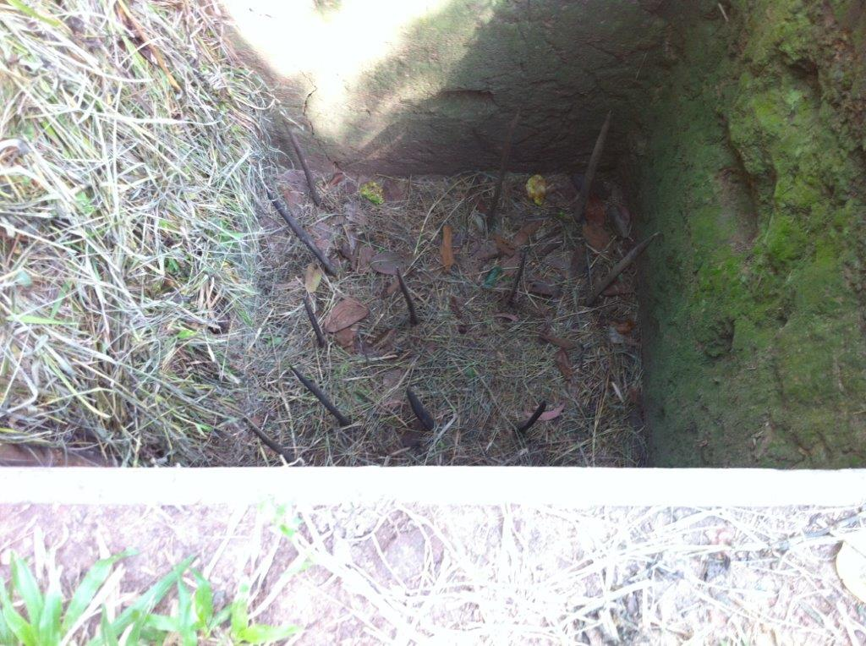
Cu Chi Tunnel Complex

Slide 28
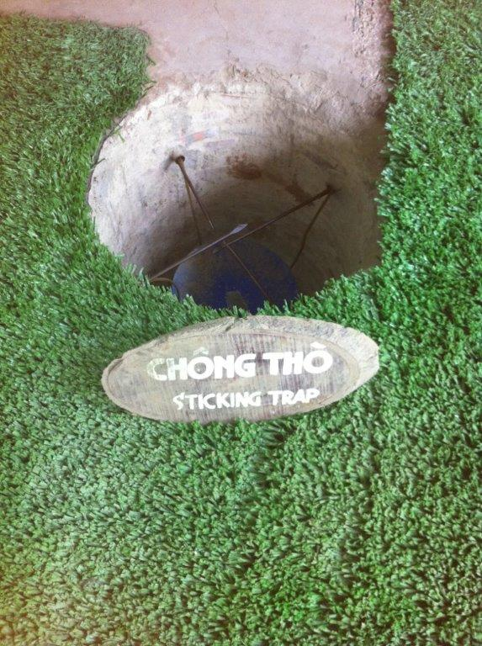
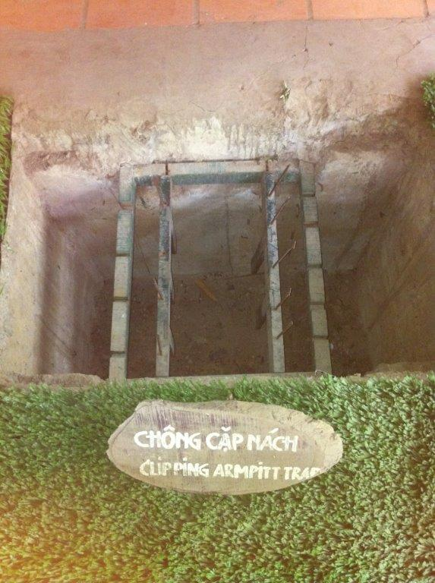
Cu Chi Tunnel Complex

Slide 29
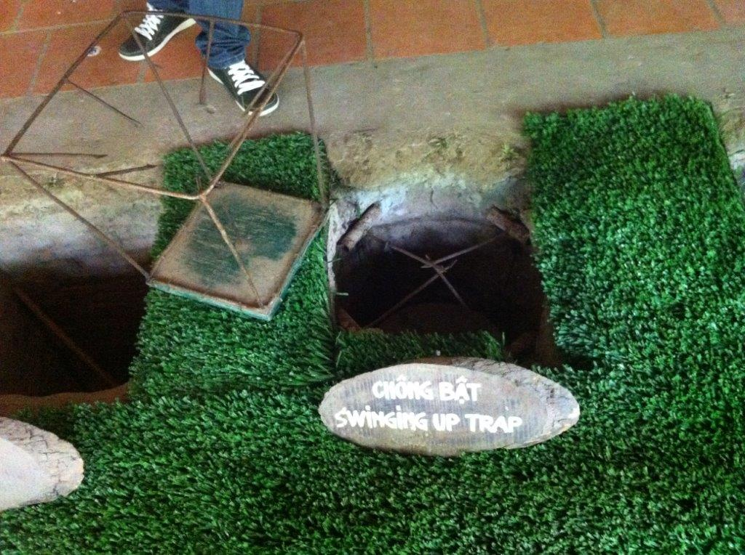
Cu Chi Tunnel Complex

Slide 30
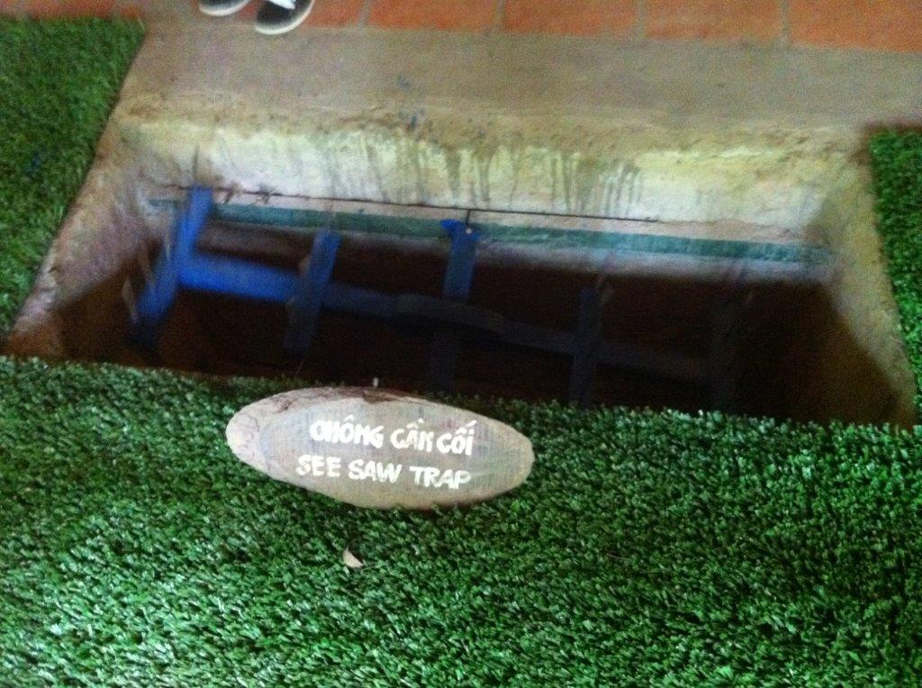
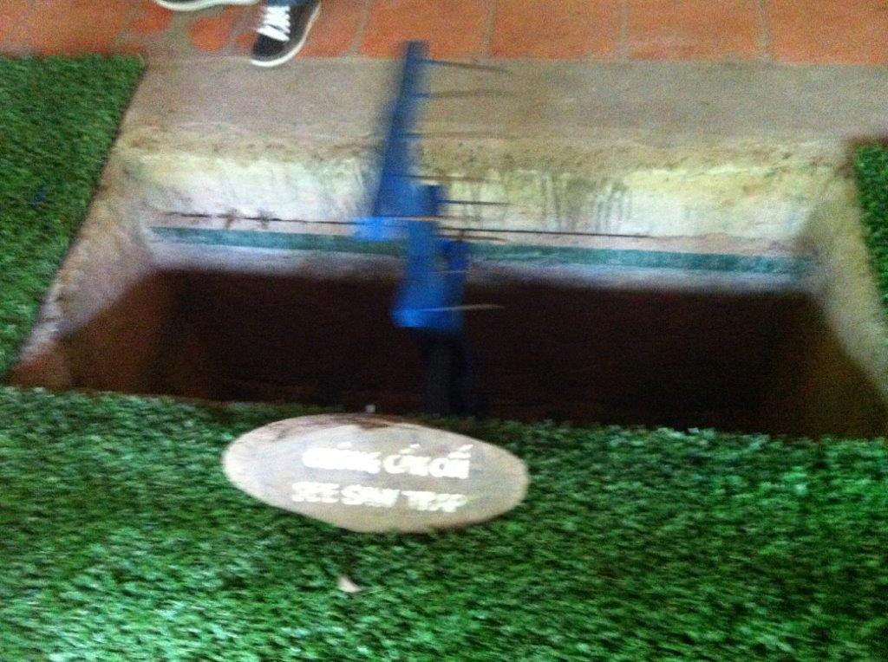
Cu Chi Tunnel Complex

Slide 31
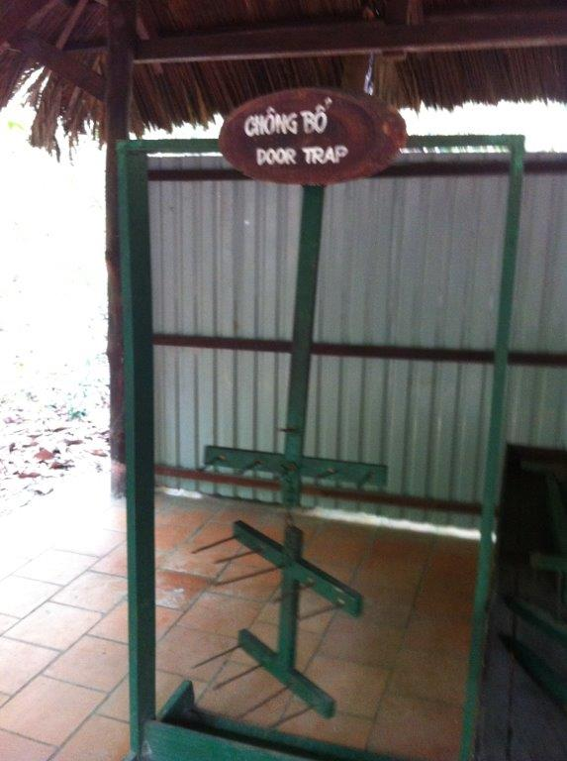
Cu Chi Tunnel Complex
‘Door Trap’ was set up so that it was pulled back, under tension and rigged to the door. When the door was opened, the trap was released, impaling whoever was in the doorway with long spikes. Unclear from the photo is that it is actually hinged between the groin spikes and the leg spikes for extra penetration…

Slide 32
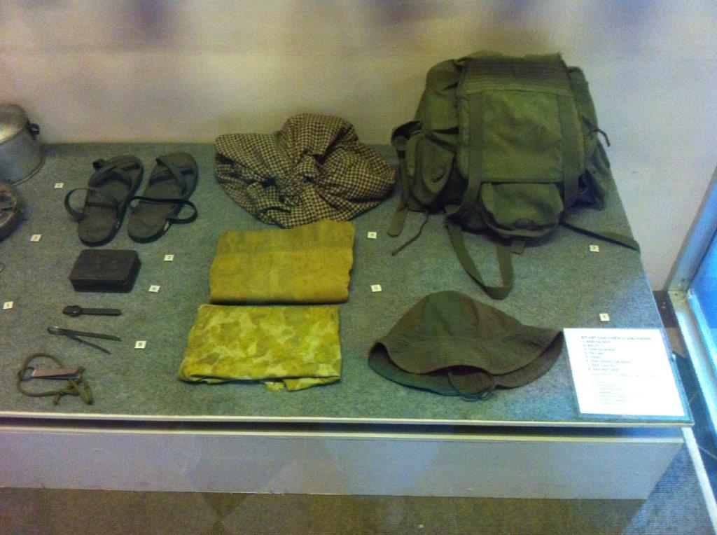
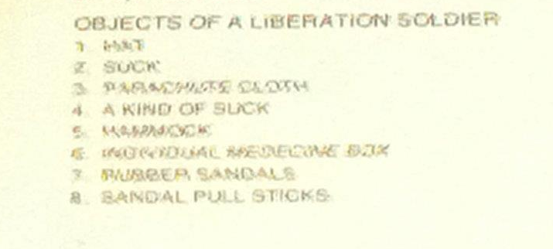
NLF soldier kit
* ‘suck’ = sack

Slide 33
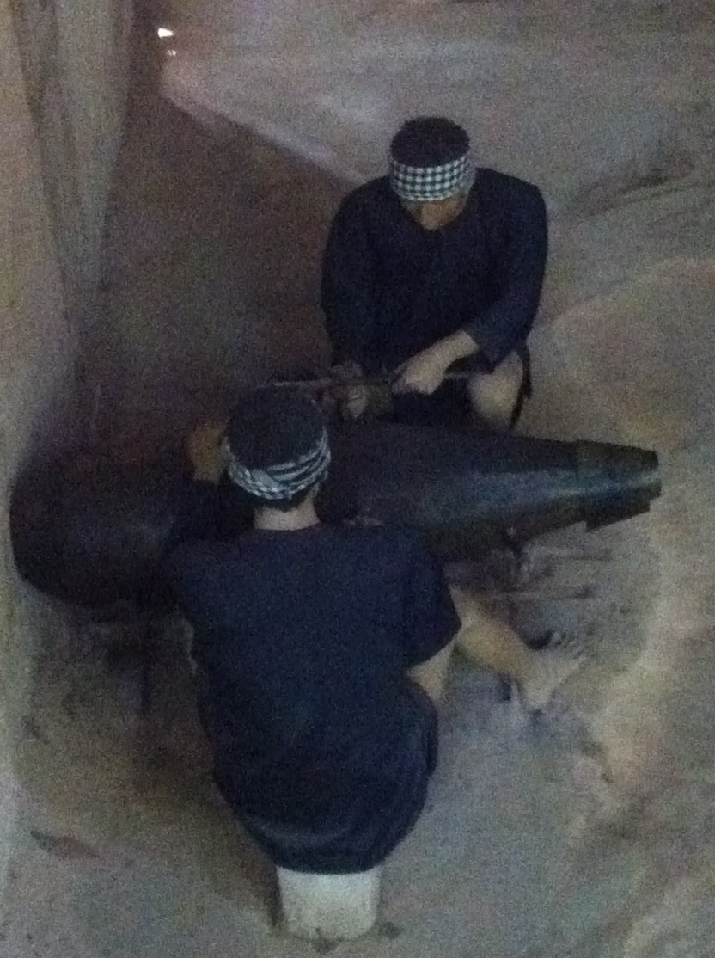
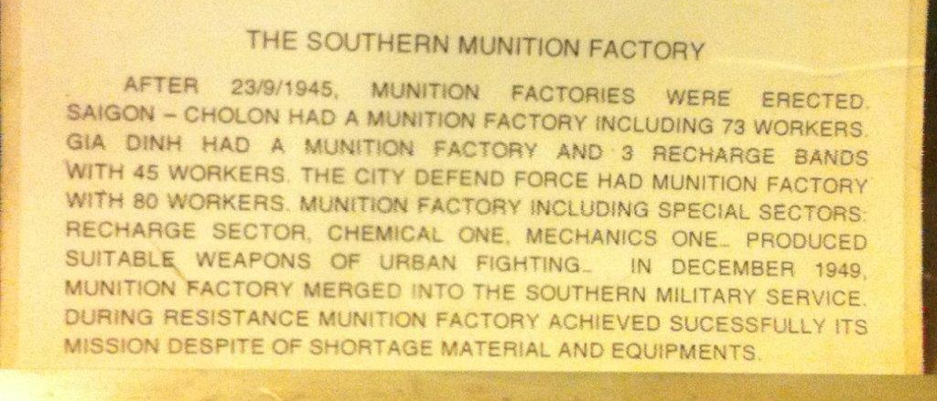
Cu Chi Tunnel Complex

